Slide 1

Project
Kaliagina Kristina
April, 2021

Slide 2



Team
Kristina Kaliagina​
Kristina_Kaliagina@epam.com
Student
Irina Ermolaeva
irina_ermolaeva@epam.com
​
Mentor

Slide 3
Overview task
Purpose - to forecast the total amount of products sold
in every shop (1 horizon)
Metrics - RMSE
___________
Repository: https://github.com/kkalyagina/epam.git

Slide 4
Description of data
 | Items
519.7+ KB object int64 int64 | Information about items item_name item_id item_category_id
 | Item_categories
1.4+ KB int64 object | Information about categories item_category_id item_category_name
 | Sales_train
134.4+ MB object int64 Int64 int64 float64 float64 | Training set date date_block_num shop_id item_id item_price item_cnt_day
Испл. Окружение:
Jupyter notebook
Python
Conda env
Git
https://github.com/kkalyagina/epam.git
 | test
4.9 MB Int64 Int64 int64 | Testing set id item_id shop_id
 | Shops
1.1+ KB Int64 object | Information about shops shop_id shop_name

Slide 5
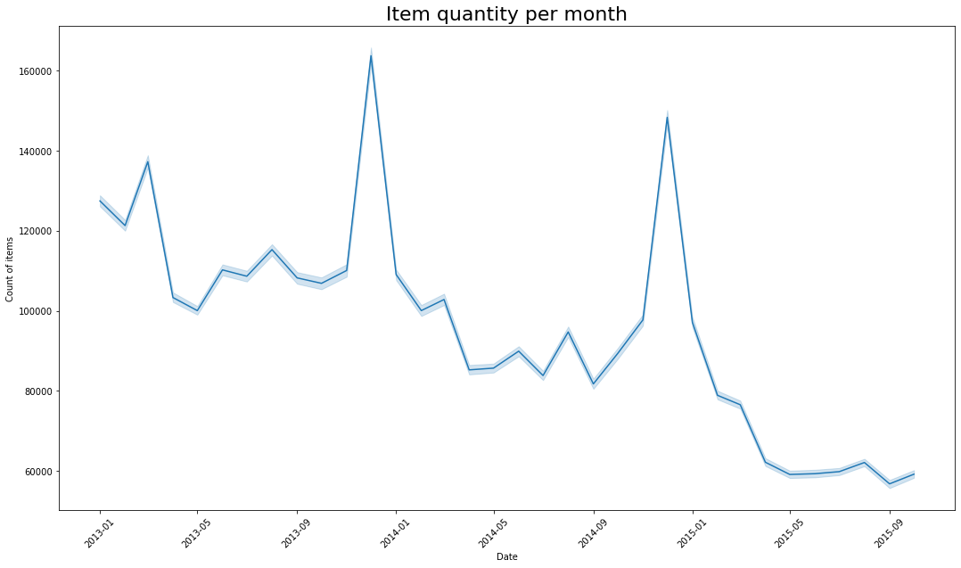
Common graphs

Slide 6
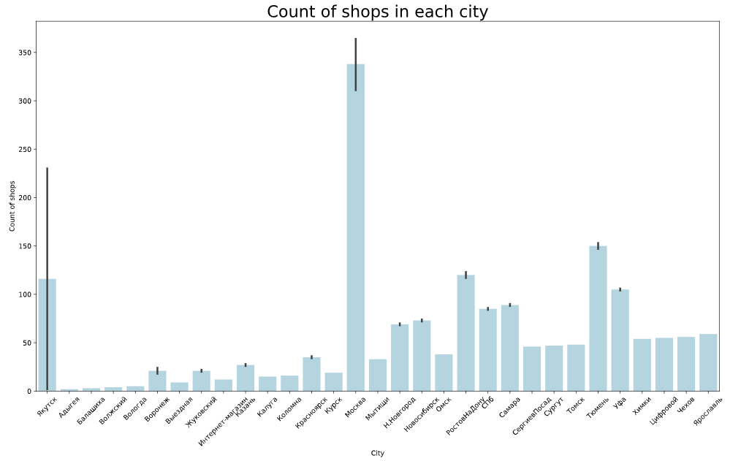
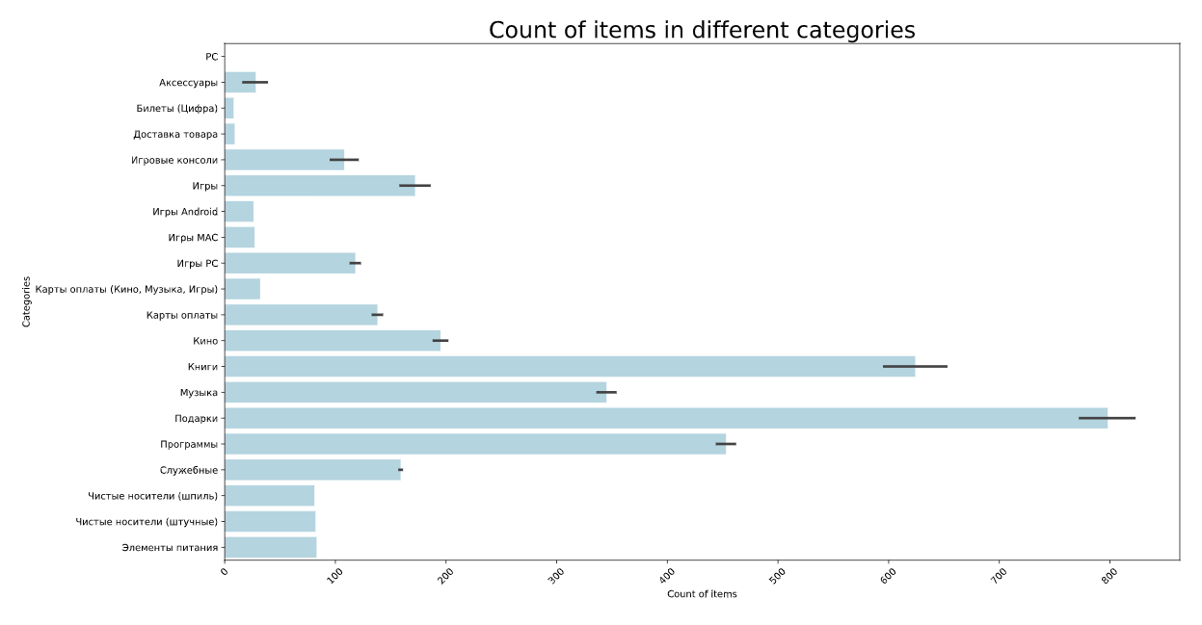
Vizualization of shops and categories

Slide 7
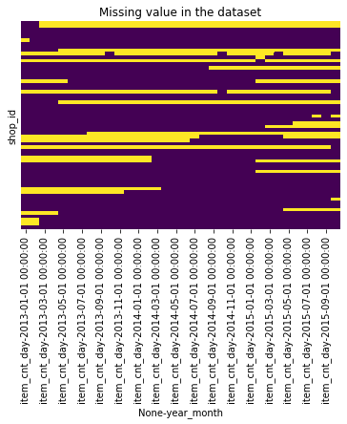
Missing values
Detalization | NaNs (%)
shop/category/item | 89%
shop/category | 41%
shop | 22%
Solutions to the problem:
filling in NaN with the mean values of items among all shops in a given month
filling in NaN with the mean value of items in each category across all shops
using IterativeImputer from sklearn

Slide 8
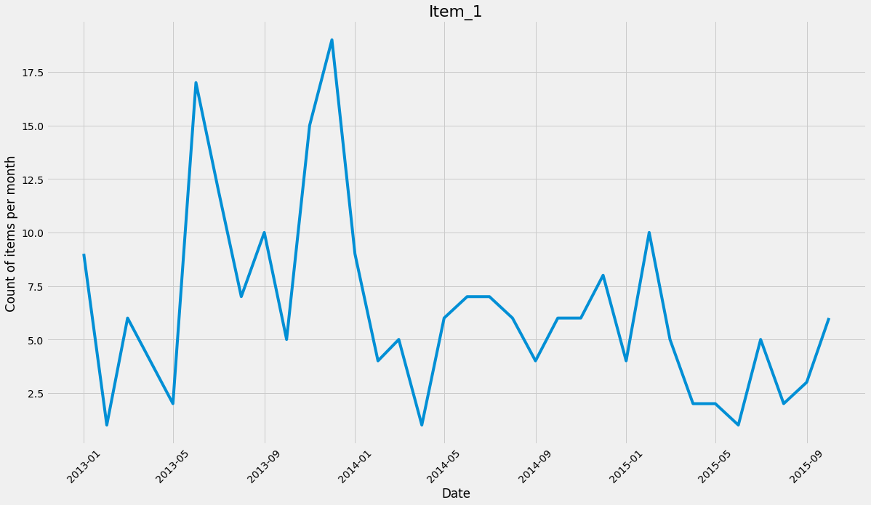
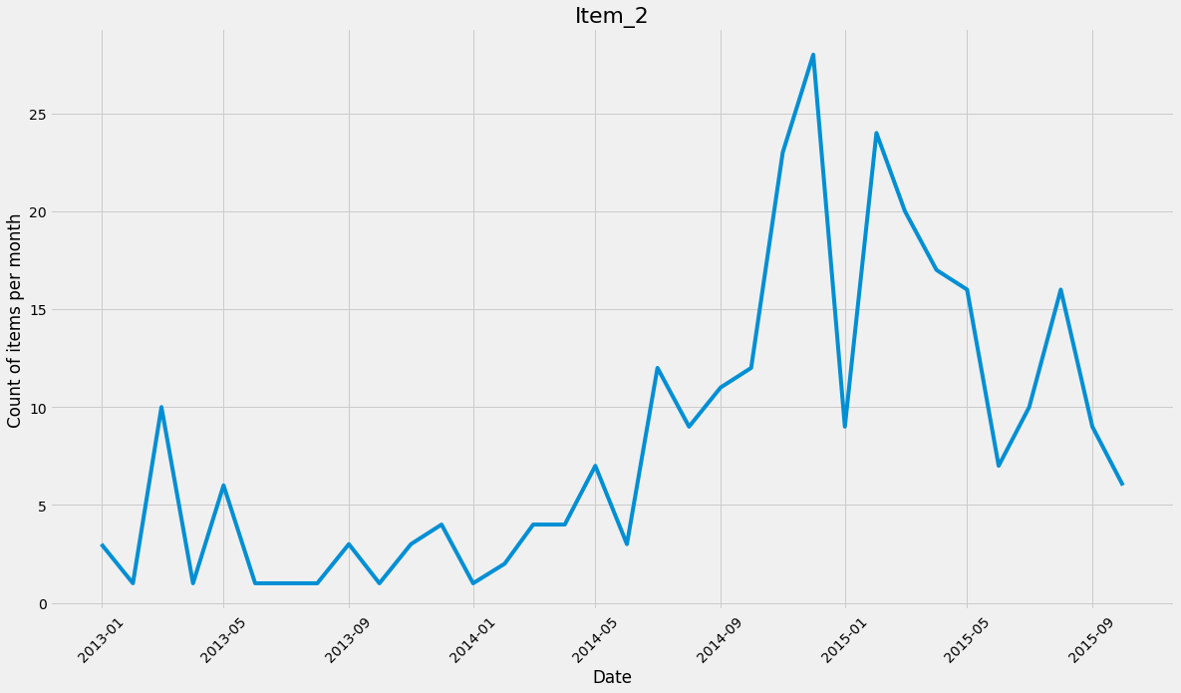
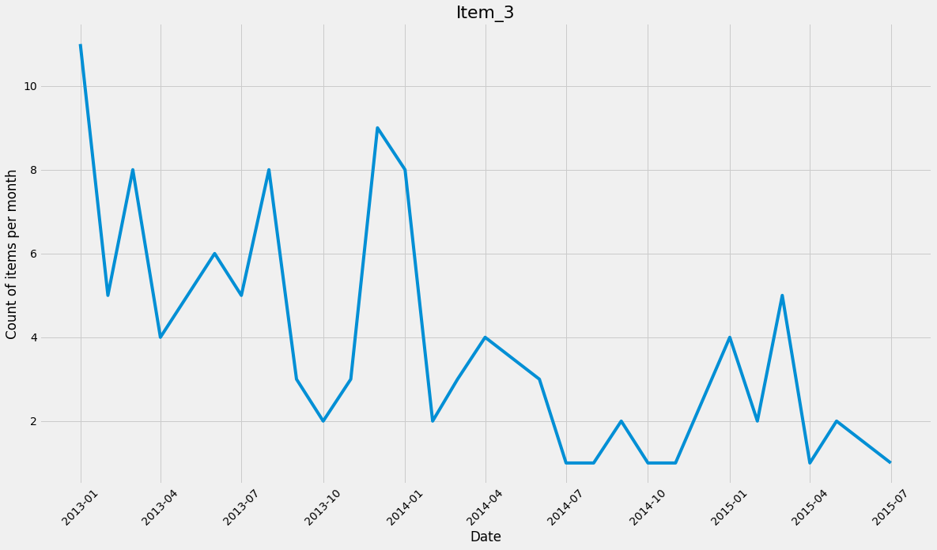
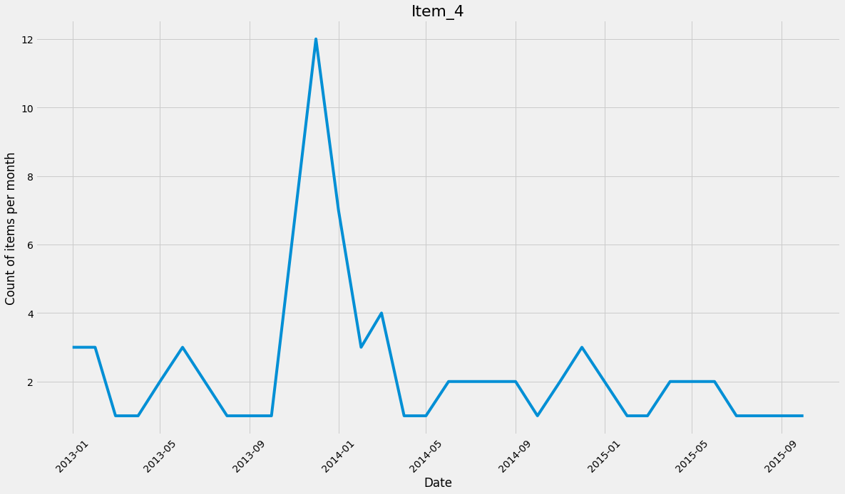
Detalization on shops/categories/items

Slide 9
Missing values
Detalization | NaNs (%)
shop/category/item | 89%
shop/category | 41%
shop | 22%
Solutions to the problem:
filling in NaN with the mean values of items among all shops in a given month
filling in NaN with the mean value of items in each category across all shops
using IterativeImputer from sklearn

Slide 10
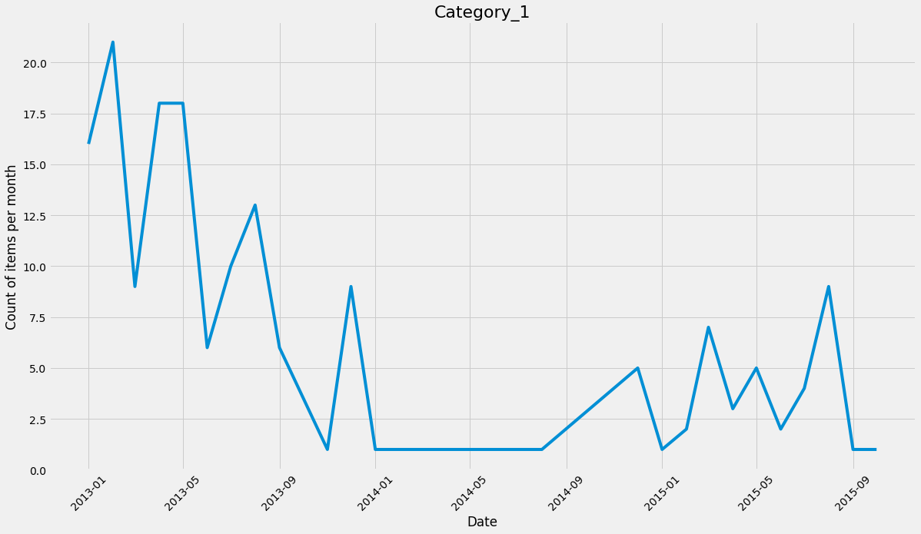
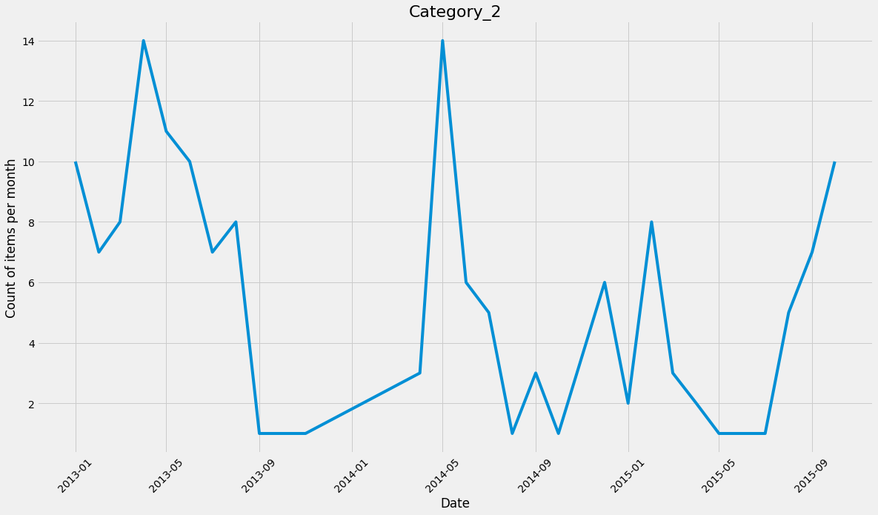
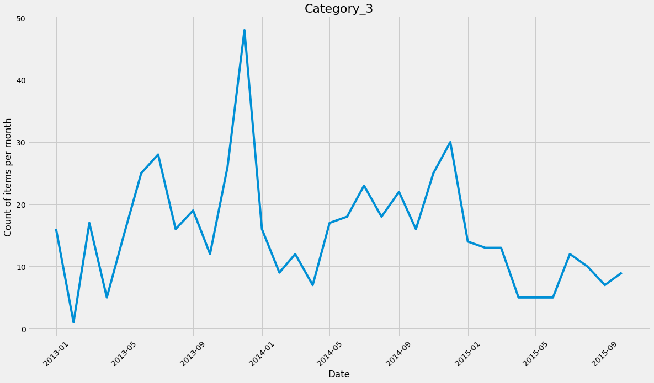
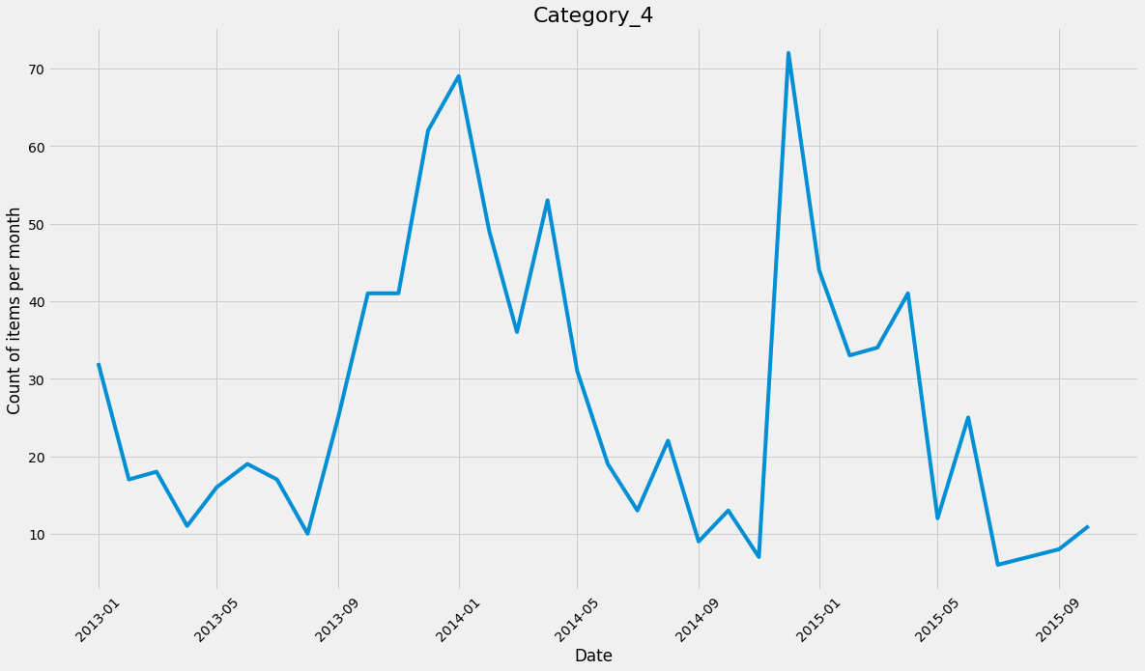
Detalization on shops/categories

Slide 11
Missing values
Detalization | NaNs (%)
shop/category/item | 89%
shop/category | 41%
shop | 22%
Solutions to the problem:
filling in NaN with the mean values of items among all shops in a given month
filling in NaN with the mean value of items in each category across all shops
using IterativeImputer from sklearn

Slide 12
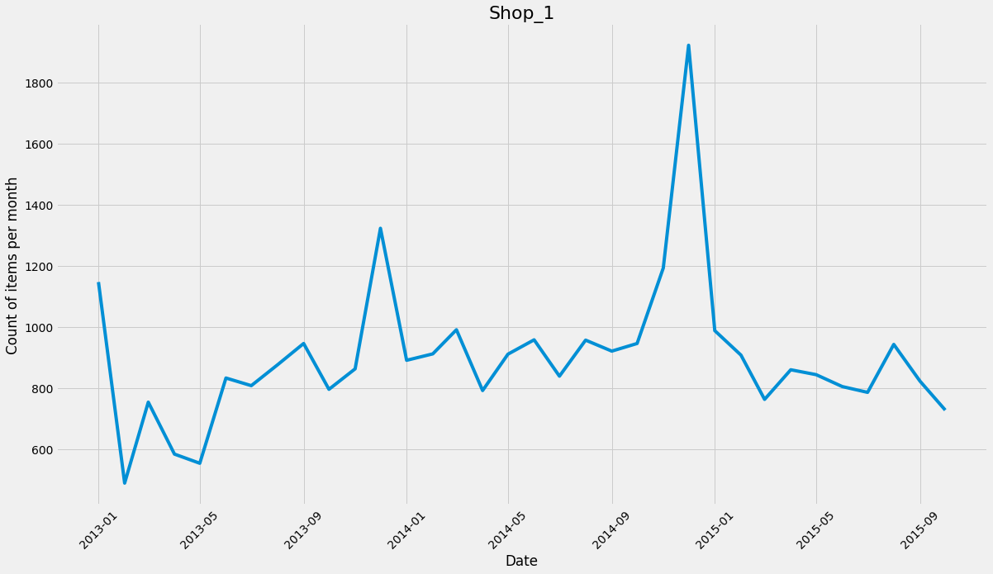
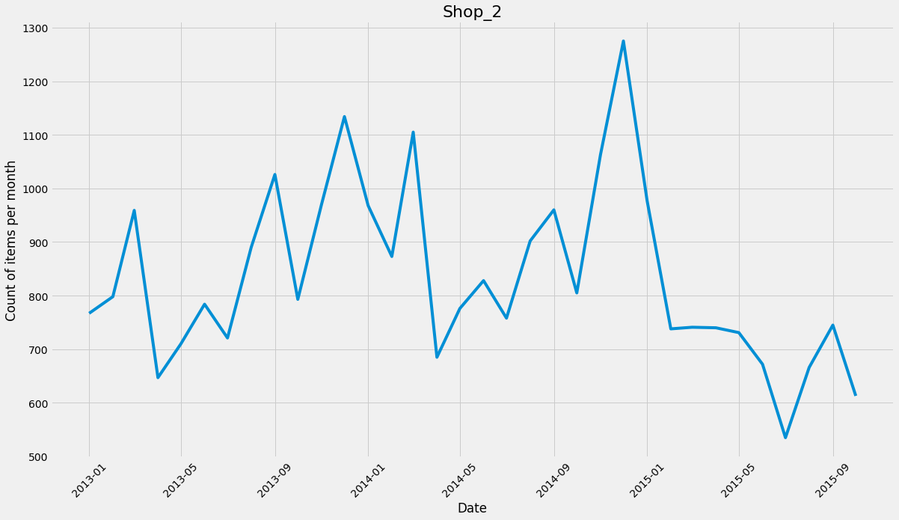
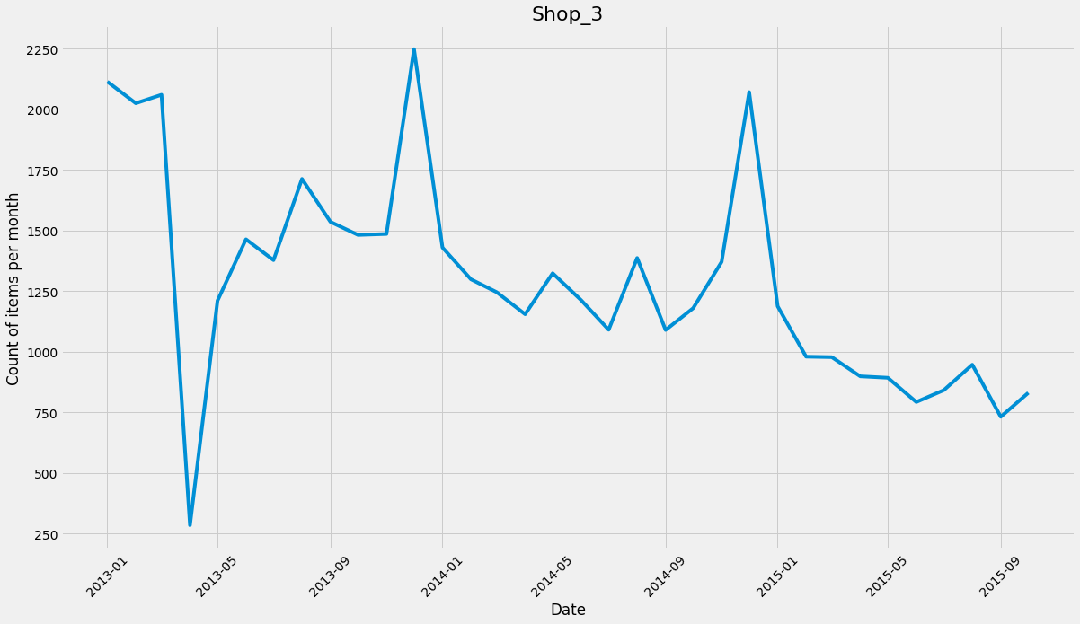
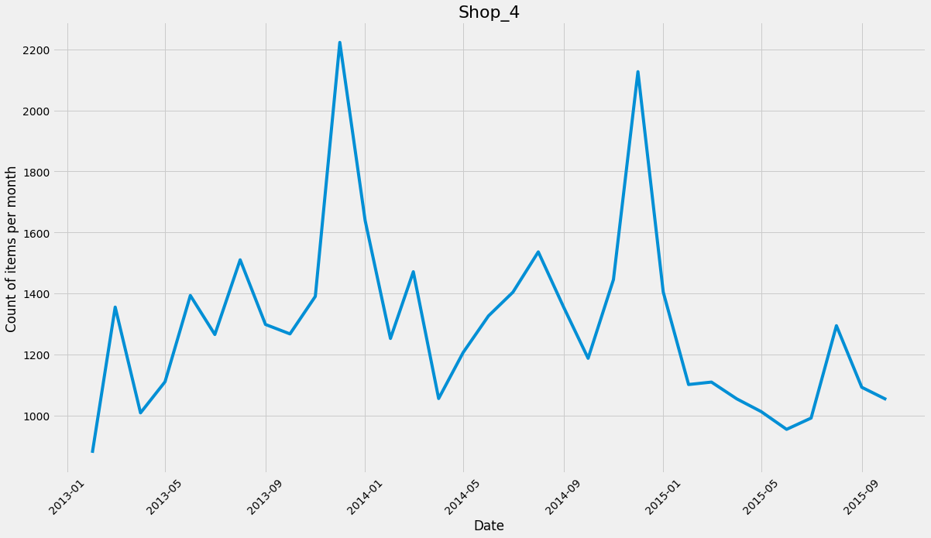
Detalization on shops

Slide 13
Missing values
Detalization | NaNs (%)
shop/category/item | 89%
shop/category | 41%
shop | 22%
Solutions to the problem:
filling in NaN with the mean values of items among all shops in a given month
filling in NaN with the mean value of items in each category across all shops
using IterativeImputer from sklearn

Slide 14
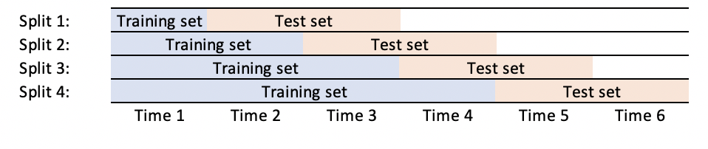
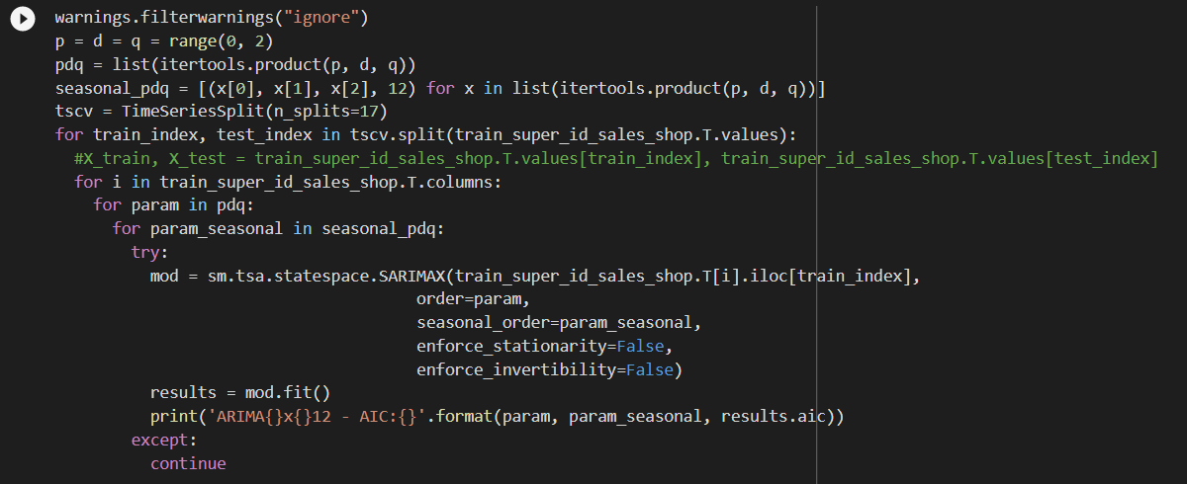
Cross-validation and selection of parameters for SARIMA

Slide 15
Comparison table of models
Model | RMSE
 | Method of filling in missing values
 | Option 1 | Option 2 | Option 3
Model 0 (Baseline) | 619.877 | 653.086 | 604.249
SimpleExpSmoothing | 366.172 | 376.695 | 349.953
SARIMA | 316.776 | 334.057 | 299.927

Slide 16
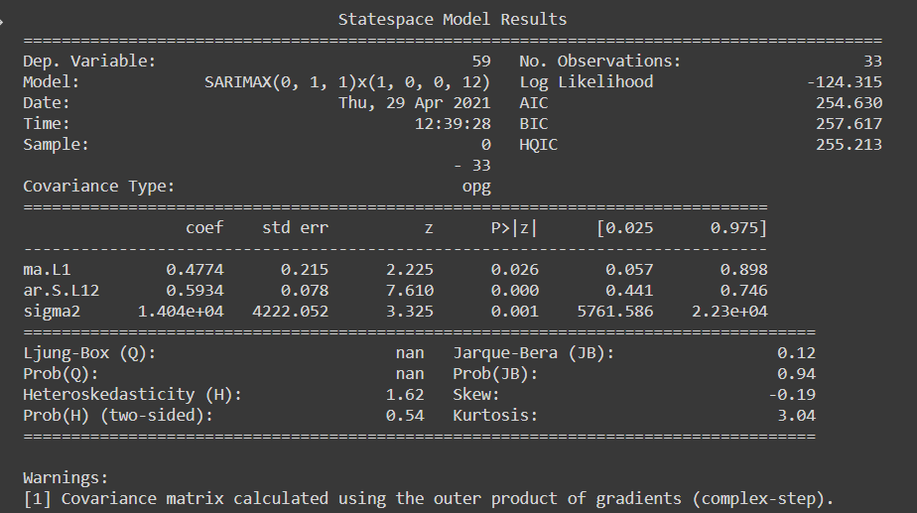
Best SARIMA model results

Slide 17
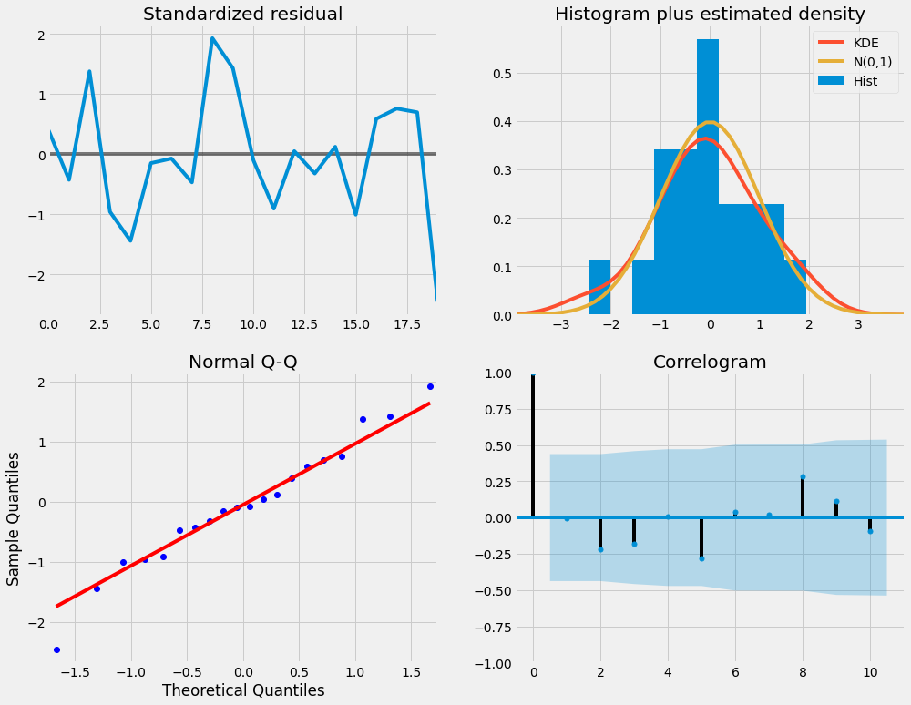
Best SARIMA model diagnostics of residuals
the residues are normally distributed
time series residuals have low correlation

Slide 18
Next steps
Technical forecast split according to item_id weights
Improved model metrics:
- tuning model
- generation of exogenous feature
Challenges
Download dataset directly from kaggle
Filling in missing values
Tuning parametres for SARIMA model

